Slide 1
Epiphany Energy Utilization 2017-22
Why are we doing this?
To establish a benchmark for energy saving discussions (how much money, carbon would a 15% savings bring?)
Provide regular (Quarterly) reporting on what we spend for gas, electric and water
Understand the climate impact of our energy usage
It’s good management – the Vestry should know
These slides are a summary of a detailed Utility Utilization spreadsheet which is available at https://3crowns.org/creationcare

Slide 2
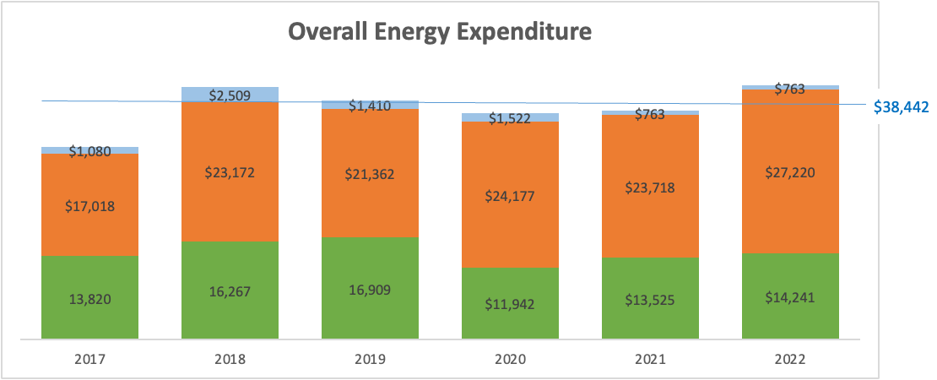

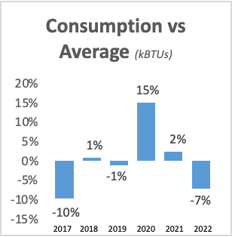
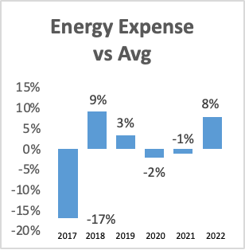
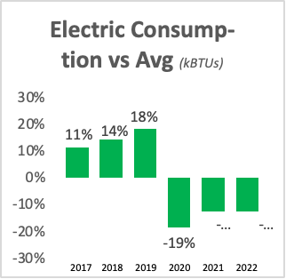
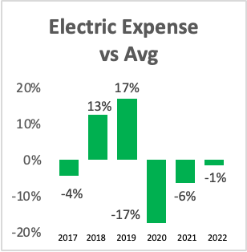
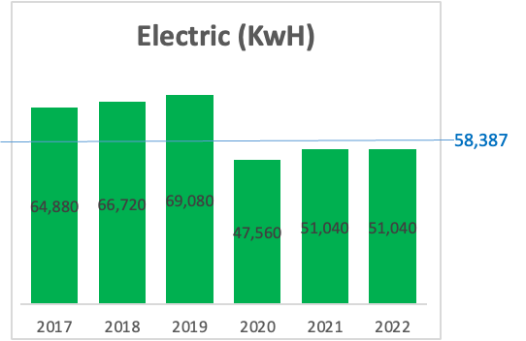
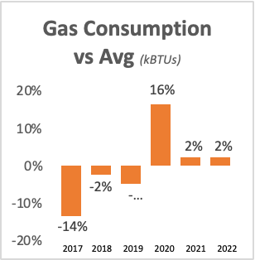
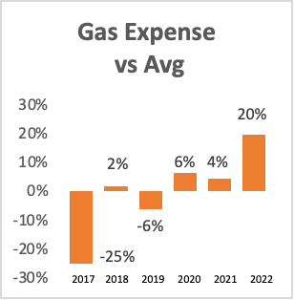
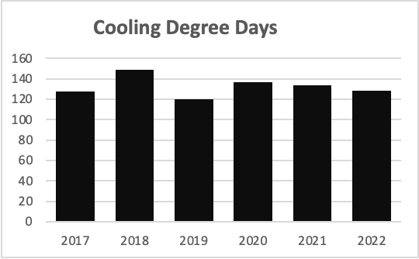
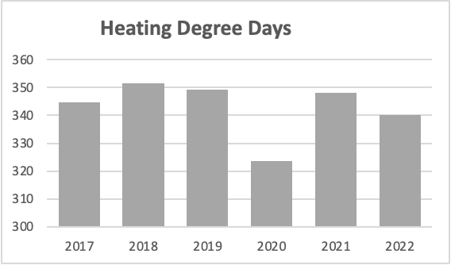
Epiphany Energy Utilization 2017-22
Expenditure versus Average
Utility Consumption

Slide 3
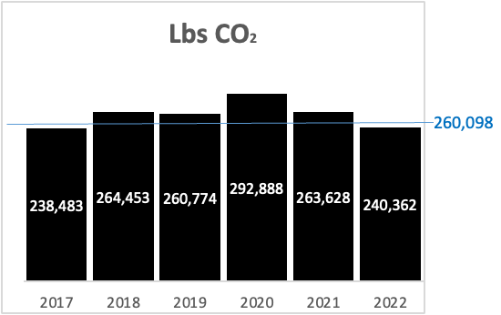
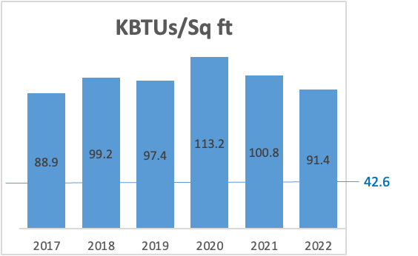
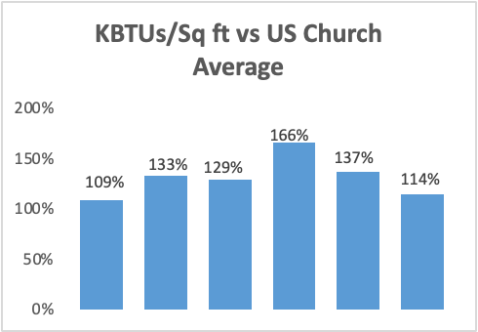
Epiphany Carbon Generation 2017-22
The CO₂ generated by our church property each year is the equivalent of the emissions from 20-22 cars driven each year.
Our goal is to reduce that to Zero by 2050.
Epiphany’s parish buildings are extremely inefficient. Our average energy efficiency (KBTUs /Square ft) is 109% - 166% worse than the US average for church buildings.

